Slide 1



Literary Criticism
(BA-TY)
Dr. Nirmala S. Padmavat
Director, IQAC
Nutan Mahavidyalaya, Selu

Slide 2

Aristotle’s observations on ‘Tragedy

Slide 3

Introduction
Aristotle’s ‘Poetics’ is chiefly concerned with tragedy. Aristotle regarded as the highest form. He has worked out the theory of tragedy with deep insight and comprehension. Aristotle says that the epic and tragedy are the outcome of the imitations of the noble actions and good men. And the satire and comedy are the outcome of the mean actions of bad men. He says that the tragedy is superior to al types of literature.

Slide 4
Tragedy: its characteristics:
Aristotle defines Tragedy as “the imitation of an action, serious, complete and of certain magnitude, in a language beautified in all different parts with different kinds of embellishments through action and not narration, and through scene of pity and fear bringing about the ‘Catharsis’ of these emotions”.

Slide 5

Tragedy: its characteristics:
This definition has two parts. The first part is concerned with tragedy as one of the imitative art, and points out its medium, objects, and manner of imitation. The second part is concerned with the function and emotional effect of Tragedy.
By serious action Aristotle means a tale of suffering exciting pity and fear. He adds, the action should complete, whole and well-knit. It means there should be organic unity, or a natural sequence of events that cannot be disturbed. In short, there should be the well beginning, the middle and the end. The plot of a tragedy should have a certain magnitude. It should be of a reasonable length. It should not be too long or too short. It should be just in proportion.

Slide 6

Tragedy: its characteristics:
The artistic ornament and form of action are two more characteristics of tragedy. By artistic ornament means use of rhythm, harmony and song and by form of action means in tragedy the tale is told with the help of living and moving characters. The speeches and actions make the tale.

Slide 7
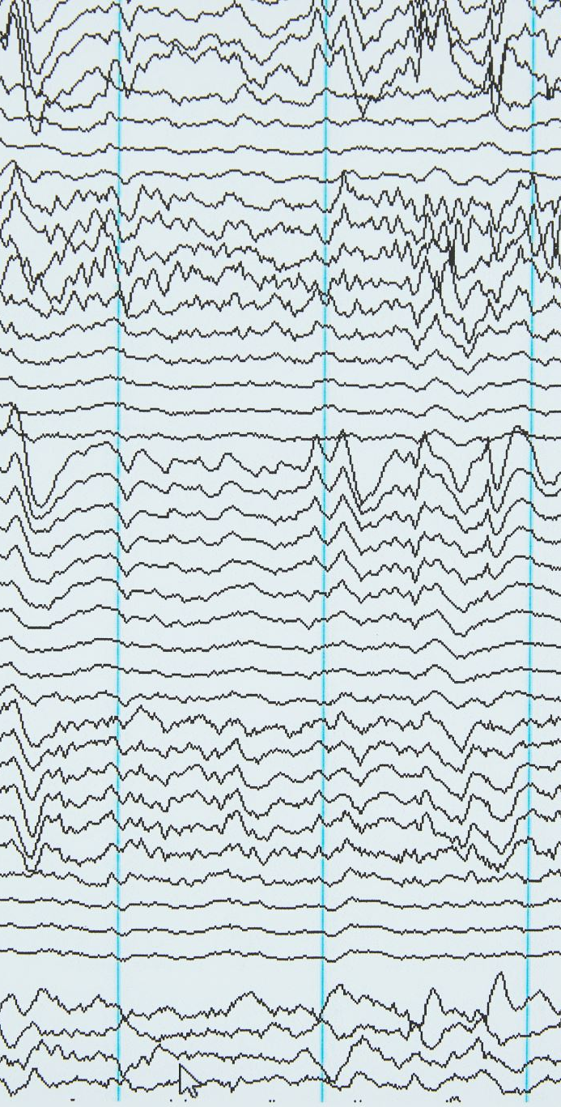
Tragedy: its constituent parts
According to Aristotle, there are six formative or constituent parts of tragedy. They are Plot, Character, Thought, Diction, Song and Spectacle. These elements of tragedy have importance in the order which they are mentioned above. The Plot or the arrangement of the incidents is the chief part of tragedy because; the tragedy is an imitation, not of men, but of an action and life. Aristotle gives more importance to Action than to Character. He adds without action there can not be a tragedy, there may be without Character, because, tragedy is written not merely to imitate men but to imitate men in action. So, Character is next only in importance to Plot. Then follows Thought or what a Character thinks or feels during his part played in the play.

Slide 8

Tragedy: its constituent parts
Thought is the intellectual element in a tragedy. It is expressed trough the speech of a character. The next element of tragedy is Diction or Language in a tragedy. It is the Language which gives us the thoughts and feeling of various Dramatic Persons i.e. Characters. It is through speech that their character is revealed. Song or the Lyrical element is to be found in the choric parts of a tragedy. It is one of the sources of the pleasure of tragedy. The Spectacle or the scenic effects have more to do with stagecraft. Aristotle is of the view that the dramatist must depend for his effects on his own powers rather than on Spectacles.

Slide 9

The structure of the plot in Tragedy
The artistic arrangement of incidents i.e. Plot is very important in tragedy. In fact, it is called ‘the soul of a tragedy’. While talking on the structure of the plot, Aristotle gives stress on only on the Unit of Action. He is against the plurality of action because, it weakens the tragic effect. There might be a number of incidents but they must be casually connected with each other. They must lead one another to one effect, the effect aimed at by the dramatist.

Slide 10
The structure of the plot in Tragedy
As regards the Unity of Action, Aristotle only once mentions it in relation to dramatic action. He says, ‘Tragedy tries, a far as possible, to live within a single revolution of the Sun, or only slightly to exceed it’. Aristotle never mentions the Unity of Place at all or even says that it is desirable to confine the action to a single place.
According to Aristotle, a good tragic plot arouses the emotions of pity and fear in spectator or the reader. He divides plot into two parts i.e. complication and denouement or in other words the rising action and the falling action.

Slide 11
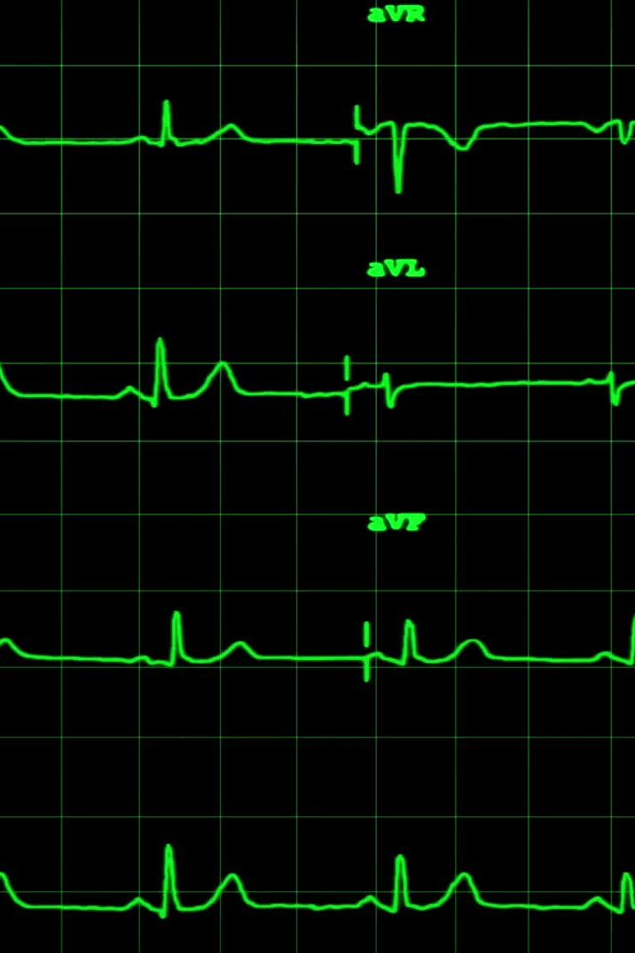
Simple and complex plot
According to Aristotle, tragic plots may be of three kinds, a) Simple b) Complex and c) Plots based on suffering and defending for their effect. Aristotle prefers complex plots. An ideal tragic plot, according to Aristotle, must not be simple. In a simple plot there is a change of fortune without Reversal of the situation and without recognition. In a complex plot change in fortune is accompanied with Reversal or recognition or both. Reversal of situation is a change by which the action turns round to its opposite.

Slide 12

Tragic Hero
According to Aristotle, the tragic hero should be a person, of great reputation and prosperity. He should be above common level, a man of high moral reputation and dignity. But, he is not a paragon of virtue. In short, he should not all good or an utter villain. In this way the tragic character must be good, but not entirely good. The fault which brings him to misfortune must be his own. His tragic end should not take place because vice, depravity and an unseen power or destiny. But fault, error or frailty of his own should bring his end quickly.

Slide 13
Three Unities
The three unities of Aristotle refer to the principles of dramatic composition as outlined by the ancient Greek philosopher Aristotle in his work "Poetics." These unities are guidelines for creating cohesive and well-structured plays in classical Greek drama. The three unities are:
Unity of Action (or Unity of Plot): The unity of action dictates that a play should have a single main plot or storyline that is focused and coherent. According to Aristotle, the plot should have a clear beginning, middle, and end, with all events and actions directly related to the central theme. Any subplots or secondary events should be closely connected to the main plot and contribute to its development. The goal is to maintain a sense of unity and avoid unnecessary digressions or distractions.

Slide 14

Three Unities
Unity of Time: The unity of time states that the events of the play should unfold within a compressed timeframe, typically taking place in a single day or, at most, within 24 hours. This limitation ensures that the action is tightly structured and avoids the passing of too much time between events. By adhering to the unity of time, the play's momentum and intensity can be maintained, heightening the dramatic impact on the audience.

Slide 15

Three Unities
Unity of Place: The unity of place stipulates that a play should take place in a single location or, at most, a limited number of closely related settings. The purpose of this unity is to avoid unnecessary scene changes and maintain a continuous flow of action. It also helps to intensify the dramatic tension and focus the audience's attention on the events unfolding within a specific spatial context.
These three unities were essential principles in the composition of classical Greek tragedies and dramas.

Slide 16
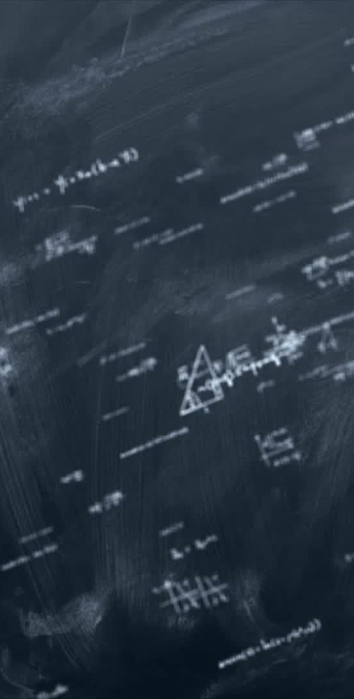
Conclusion:
Thus, Aristotle in his Poetics gives the canons of the tragedy. Though, his definition, observations on tragedy are controversial, they are fundamental in the history of criticism.

Slide 17
Thank you!

